Slide 1

INDUSTRIAL INTERNSHIP
Yagya Foundry
By: Premanand Pathak
Roll No: 019048

Slide 2
OUTLINES
Company Overview
Vision
Mission
Goal
Ongoing Projects
Internship Details
Conclusion

Slide 3
Company Overview
Yagya Foundry was established in 2024 as a private company focused on advancing electronics, AI/Ml and IoT-based solutions. Headquarters in NTIC the company specializes in the design, development, and manufacturing of innovative electronic systems
Yagya Foundry has aimed to provide cutting-edge solutions for industrial and consumer electronics, leveraging modern technologies like microcontrollers and wireless communication modules.
Over the years, Yagya Foundry has grown to support various projects in the field of IoT and AI/ML contributing to advancements in automation and smart systems.

Slide 4
Vision
To become a nationally recognized leader in robotics, automation,AI/ML and technology-based education and solutions.

Slide 5
Mission
To develop innovative and sustainable electronics and AI/ML solutions that enhance productivity, learning, and human potential.

Slide 6
Goal
Promote robotics and AI education
Provide reliable electronics products
Encourage innovation and research.

Slide 7
Ongoing Projects
Smart Agriculture System
Environmental Monitoring Solution:
STEAM Education

Slide 8
Internship Details
Study of IoT Circuit Diagrams and Instructions
Component Verification and Quality Checks
Arduino Programming and Testing
Circuit Simulation and Debugging
Documentation and Reporting

Slide 9
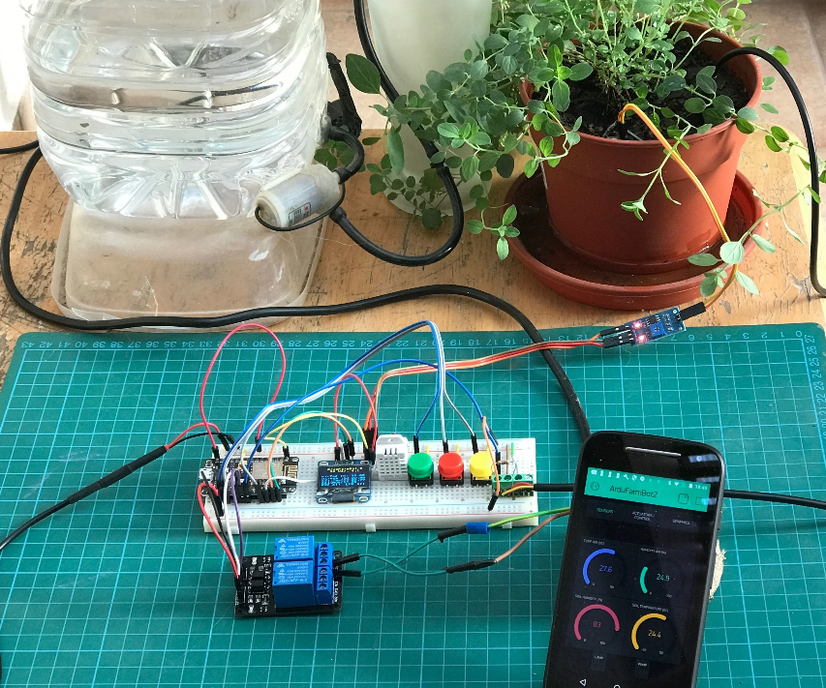
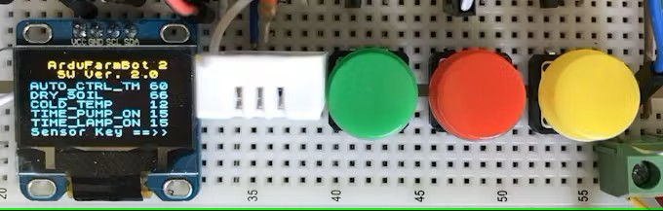
Fig: Smart Agriculture System

Slide 10
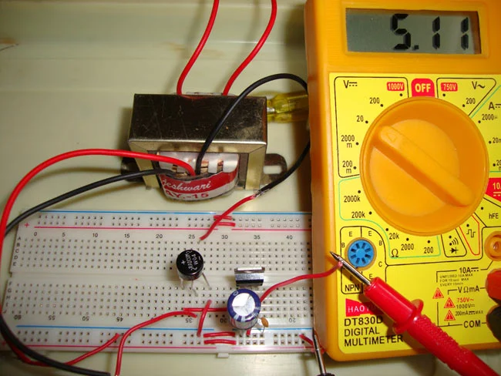
Fig: Circuit Testing For Inverter Automation

Slide 11
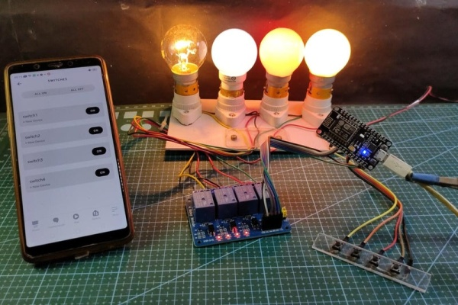
Fig: Testing Of Home Automation

Slide 12
Conclusion
My internship at Yagya Foundry has experience in the field of electrical and electronics engineering, AI/ML specifically in the design, assembly, and testing of IoT-based and sensor-based systems and Model deployment
The challenges faced, such as debugging complex wiring in the ultrasonic sensor circuit and configuring the Wi-Fi module for the IoT project, taught me the importance of perseverance and systematic problem-solving.

